Slide 1




Text Mining Final Project Pitch
Group 5: Emma Kramer (speaking), Chuhan Peng, Yujie Fu, Zhoulin Zhuo

Slide 2
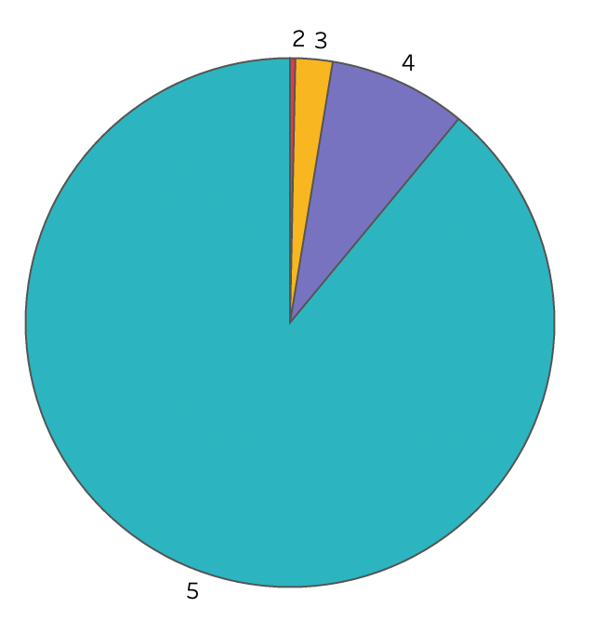
Description of Data
Overall Product Ratings
The data is from Amazon product data created by Julian McAuley, UCSD
http://snap.stanford.edu/data/amazon/productGraph/categoryFiles/
reviews_Toys_and_Games_5.json.gz
The dataset contains Amazon product reviews, including 142.8 million reviews from May 1996 - July 2014
The data we used is a sample of reviews of toys and games sold on Amazon
We specifically looked at reviews for the game Cards Against Humanity
309 reviews total
Timeframe: 2013-2014
Possible Shortcomings
There is a possible selection bias in this dataset because only certain people decide to leave product reviews
Usually people only leave a review if they are very satisfied or very unsatisfied with the product

Slide 3
Objective of Analysis
Find the key themes/ topics being discussed in the product reviews
Help the company understand customers’ preferences
The main topic keywords are “fun”, “friends”, “family”, “laugh”
Use the keywords in product description to encourage the customers to buy the game
Determine if the product reviews are mostly positive or negative
Evaluate the sentiment of customers, so that businesses can improve customer satisfaction

Slide 4
Text Mining Methods
Text Data Pre-Processing
Normalization
Tokenization
Vectorization
Get rid of unimportant features (stop words)
Convert text into matrix - Bag of Words
Text Classification
Feature selection
Topic Modeling
Visualize the “distance” between topics with different lambda
Divided all reviews into 8 topics
List Top-10 Most Salient Terms for each topic
Sentiment Analysis
Afinn, Vader Lexicons (Unsupervised)
SVM (Supervised)

